Slide 1

ISCG6420 JavaScript
Semester 1, 2017
Notes:
Use title slide layout

Slide 2
What is JavaScript?
Programming language used to make interactive web pages
JS is a scripting language that is interpreted by the browser
Runs on client’s computer/browser (no need to have a server)
Object based
Does not need to be compiled - interpreted language

Slide 3
Variables
JS variables are containers for storing data values
Rules for specifying names for variables:
Contain letters, digits, underscores, and dollar signs
Must begin with a letter
Names are case sensitive
Cannot use reserved words
Uses camel case

Slide 4
Data Types of Variables
Numbers
Strings
Arrays
Boolean
Objects

Slide 5
Operators
Addition + Subtraction – Multiplication * Division / Modulus % Increment ++ Equal to == Not equal != Greater than > Less than < Greater than or equal >= Less than or equal <=
Assignment = Logical AND && Logical OR || Logical NOT !

Slide 6
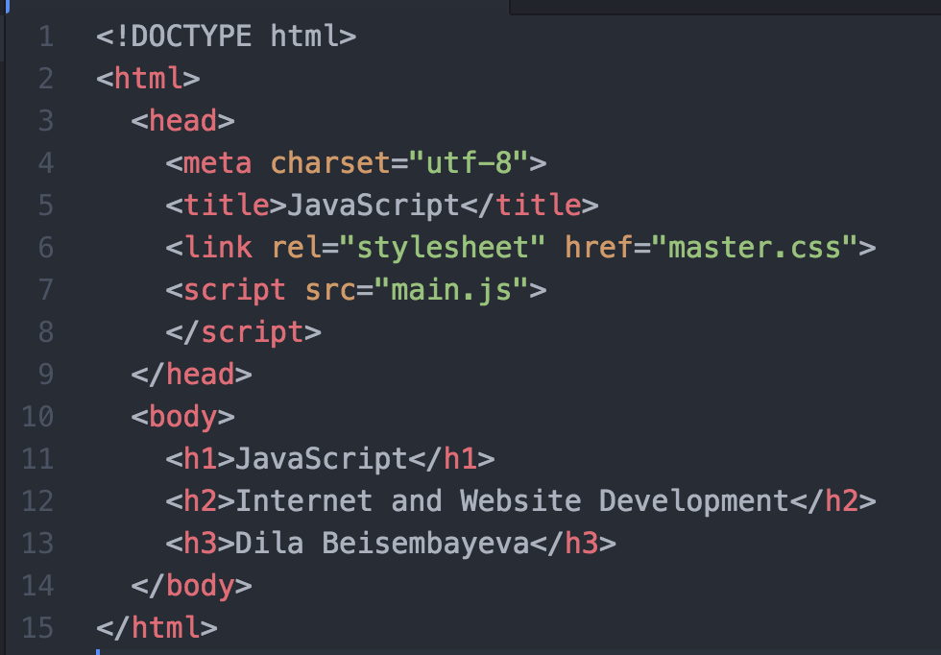

Slide 7
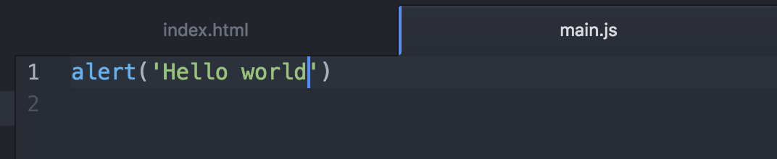
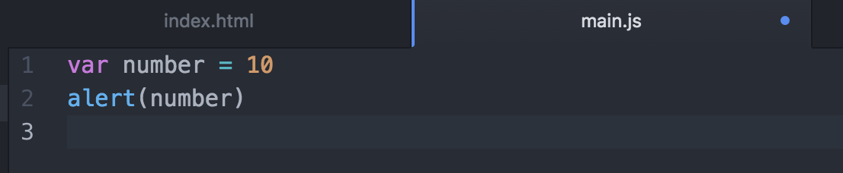
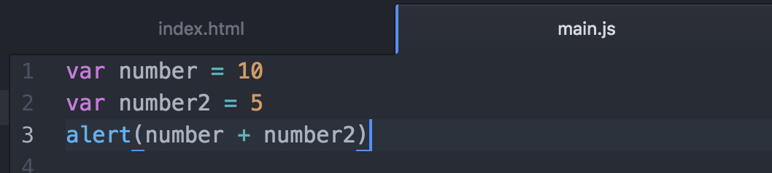
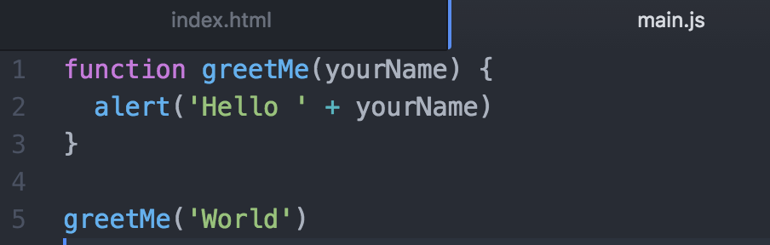

Slide 8
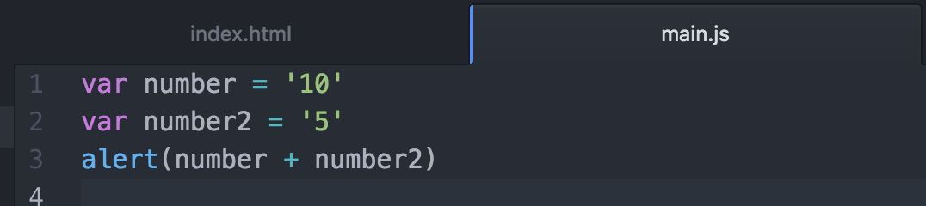

Slide 9
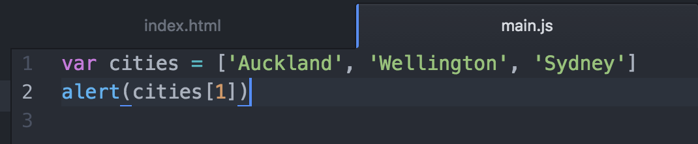
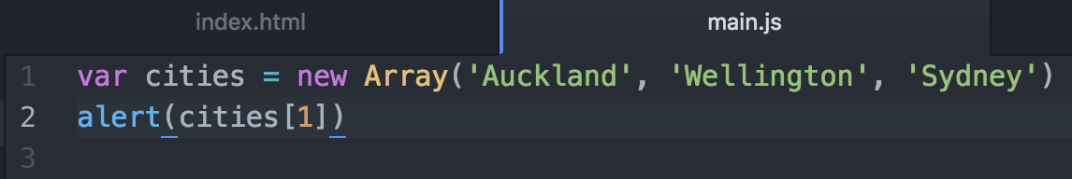
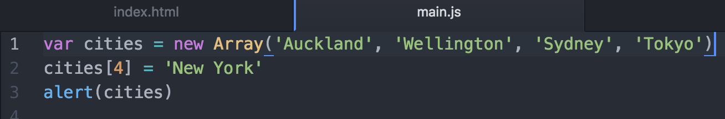
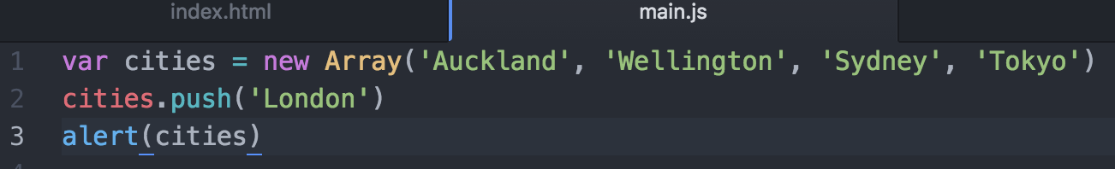

Slide 10
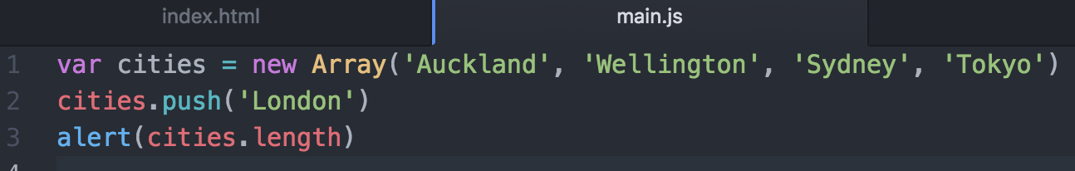
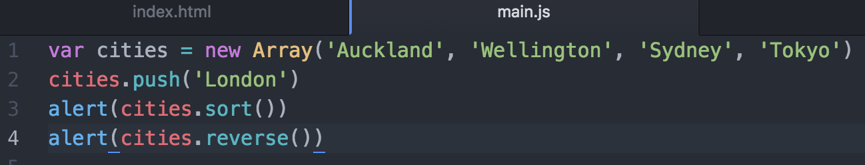

Slide 11
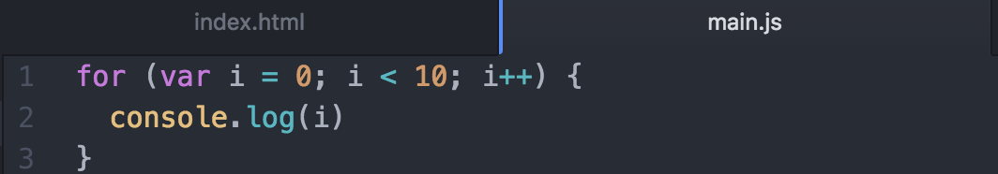
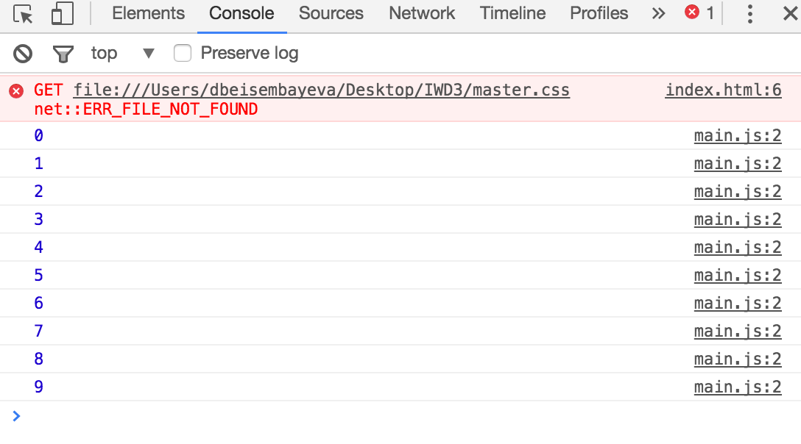

Slide 12
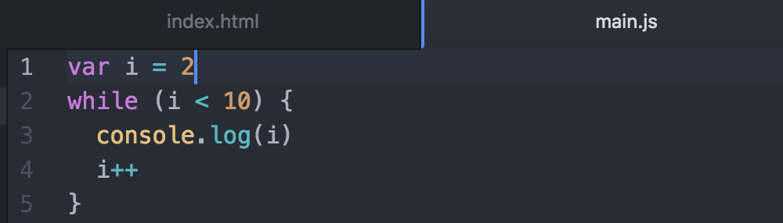
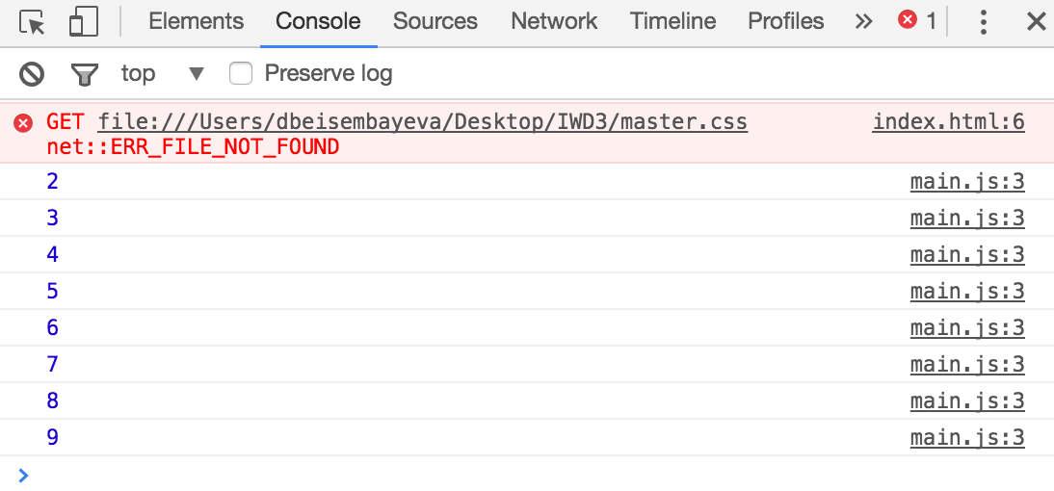

Slide 13
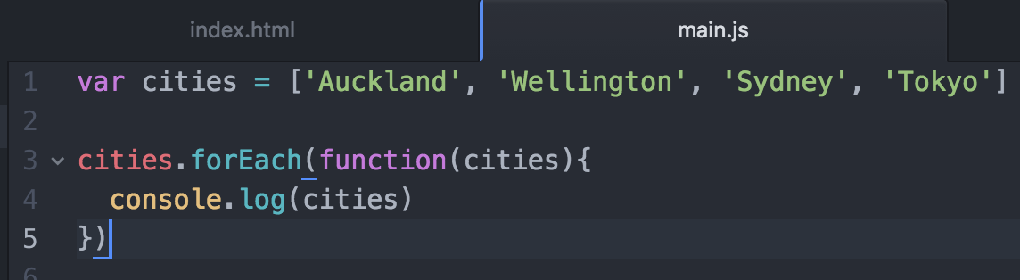
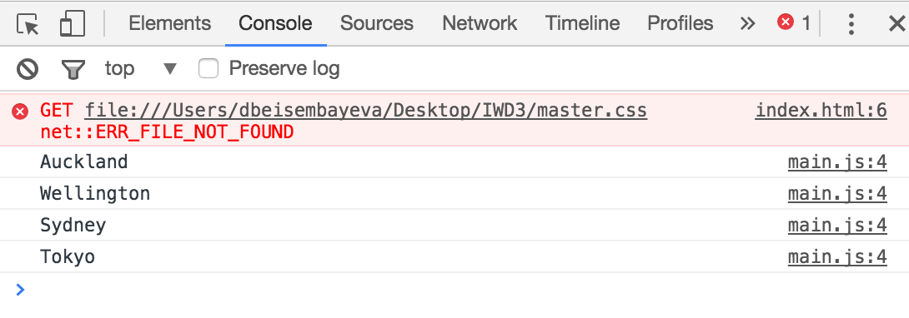

Slide 14
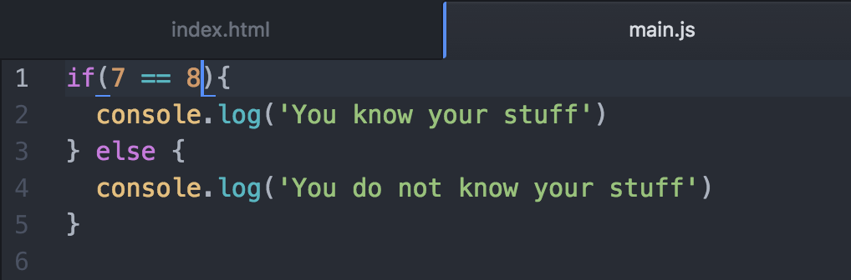

Slide 15
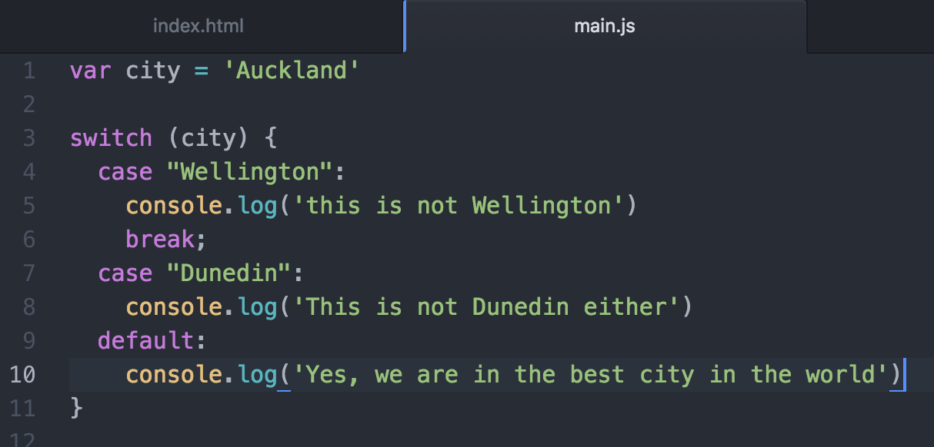

Slide 16
Objects
JS is designed in a simple object-based paradigm. An object is a collection of properties, and a property is an association between a name and a value. A property’s value can be a function, in which case the property is known as a method.
In JS, an object is a standalone entity, with properties and type. Properties define object’s characteristics.
Example: a cup is an object with properties. A cup has a color, a design, weight, a material it is made of.

Slide 17
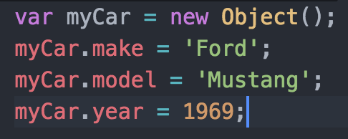
Objects and properties
A JS object has properties associated with it. A property of an object can be explained as a variable attached to the object. Object properties are basically the same as ordinary JS variables, except for the attachment to objects. The properties of an object define the characteristics of the object. You access the properties of an object with a simple dot-notation:
objectName.propertyName

Slide 18

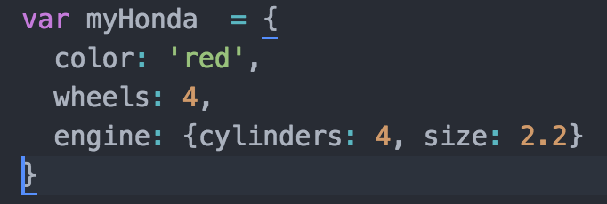
Creating new objects
An empty object with no properties can be created like this:
This creates an object with three properties:

Slide 19
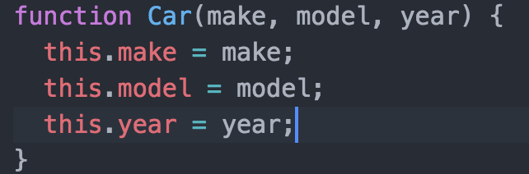
Using a constructor function
You can also create an object using the following:
Define an object type by writing a constructor function
Create an instance of the object with new

Slide 20
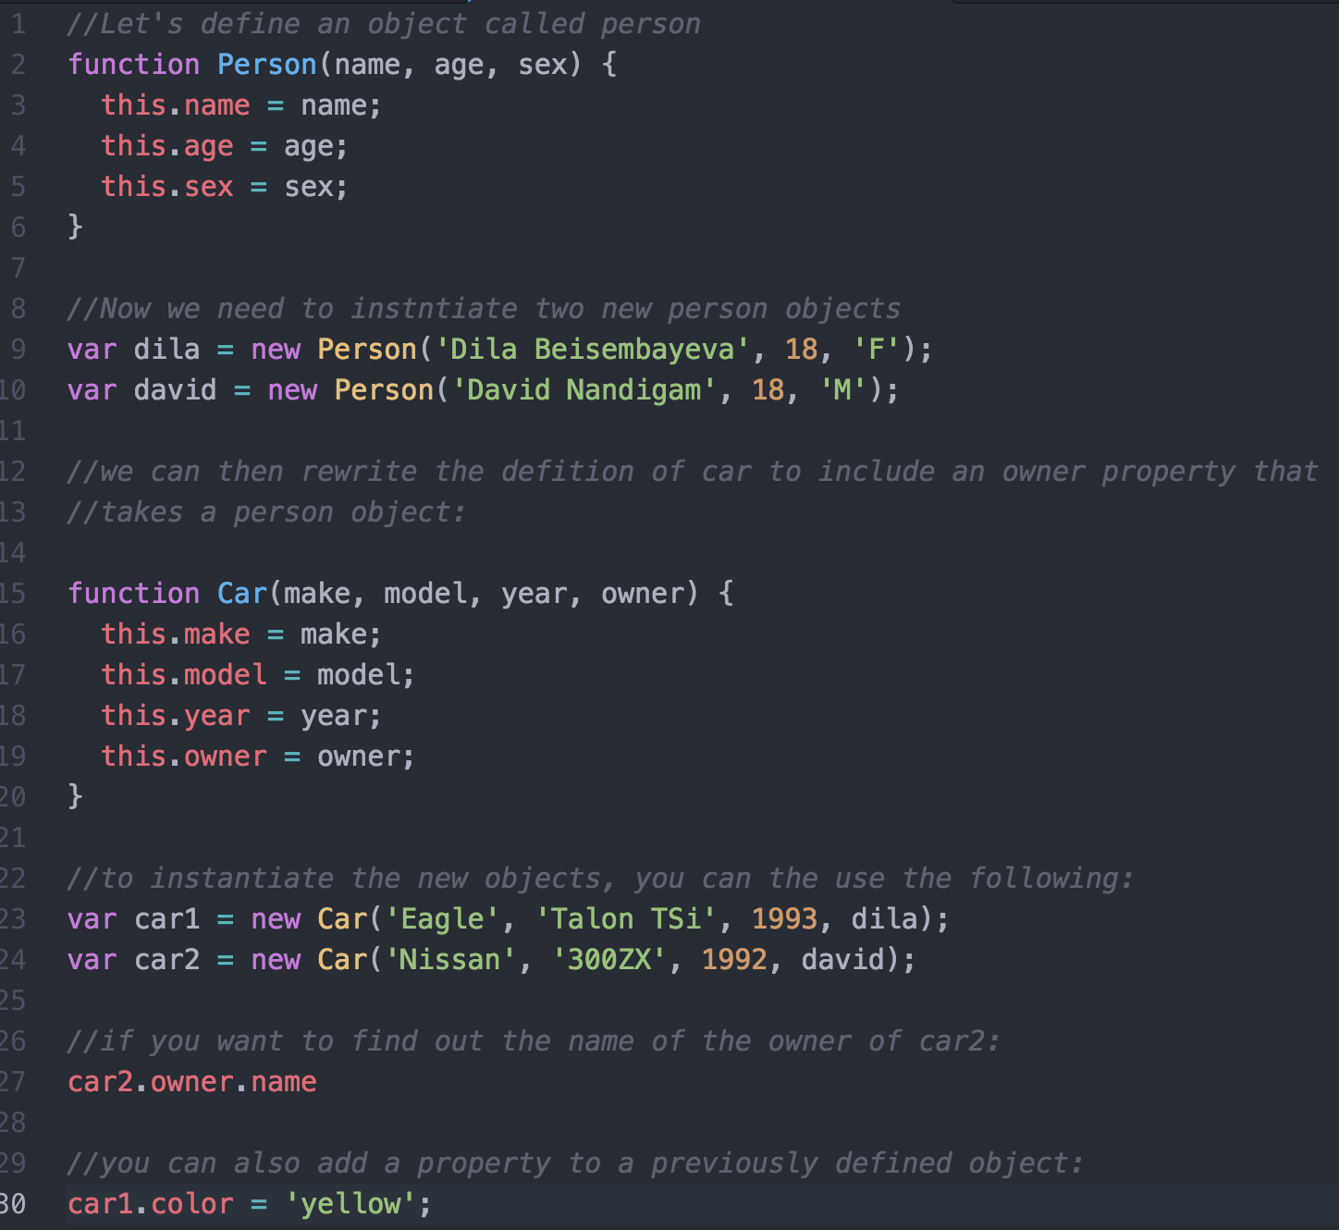

Slide 21
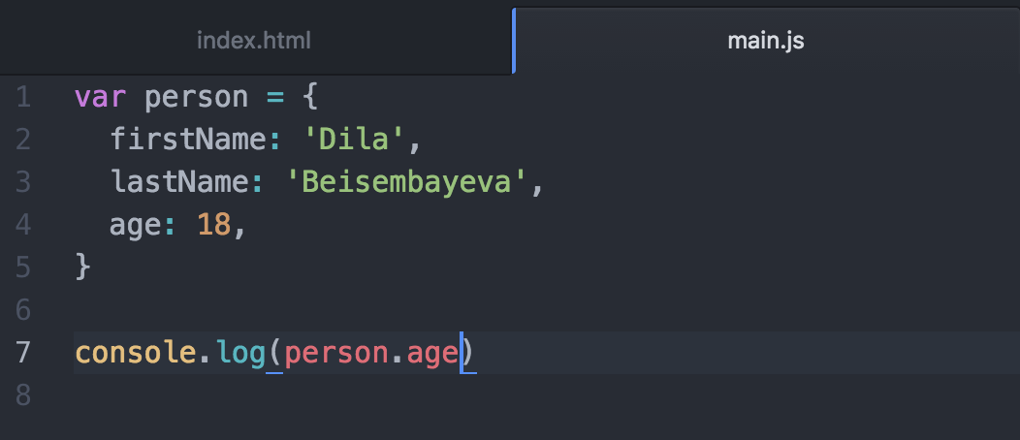
Objects

Slide 22
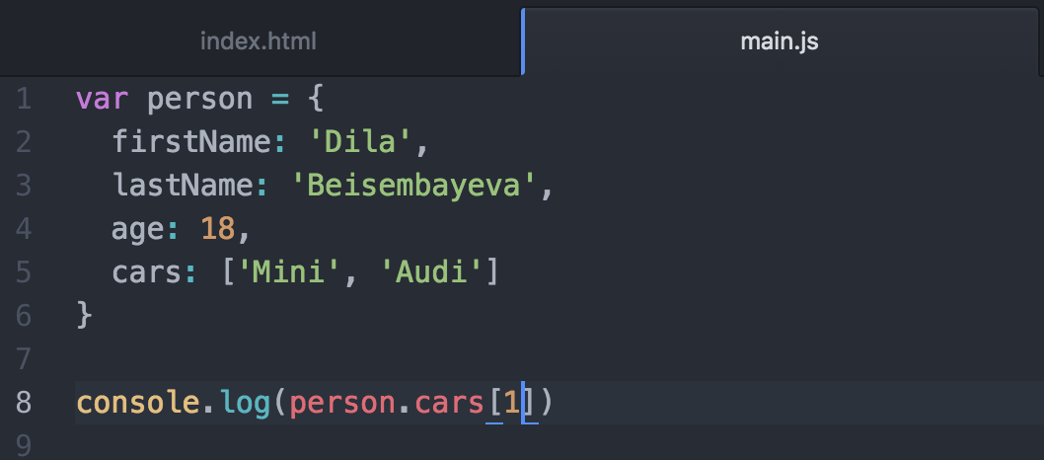

Slide 23
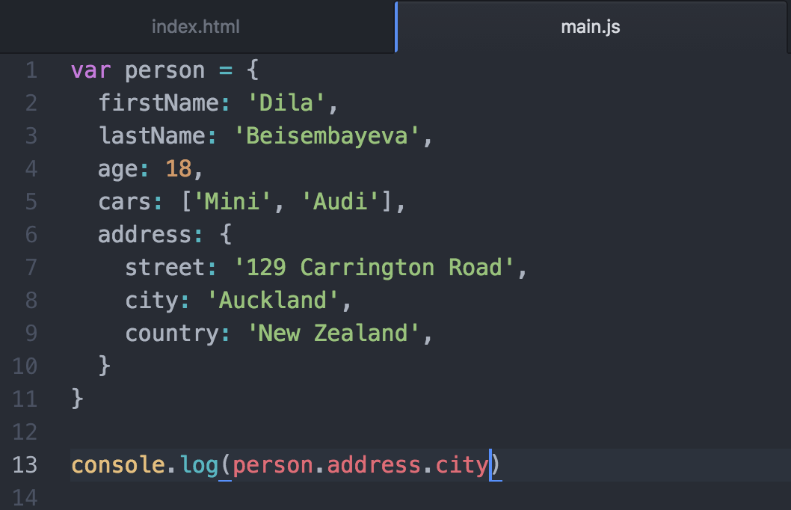
Object Literal

Slide 24
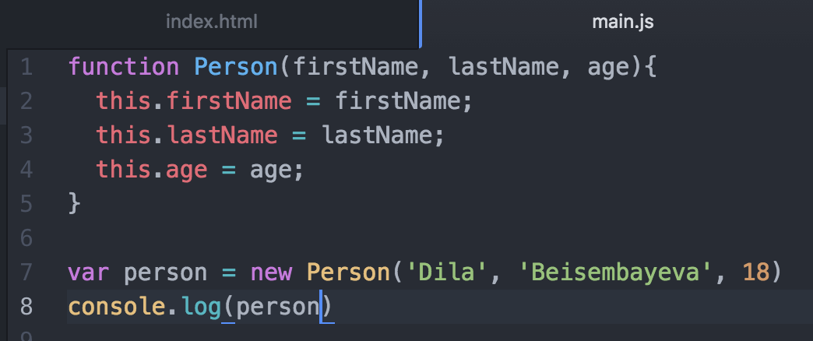
Object Constructor

Slide 25
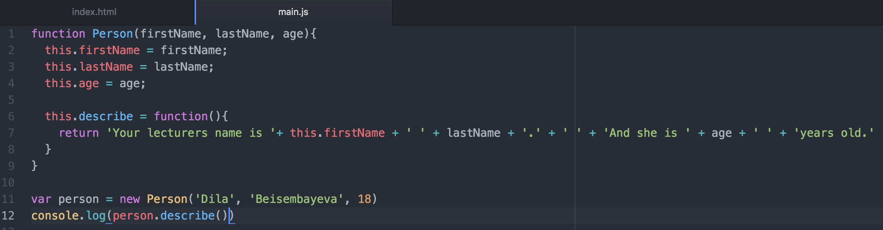

Slide 26
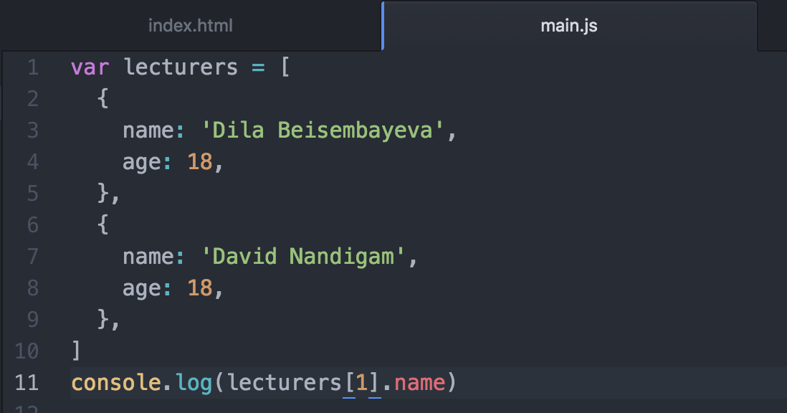

Slide 27
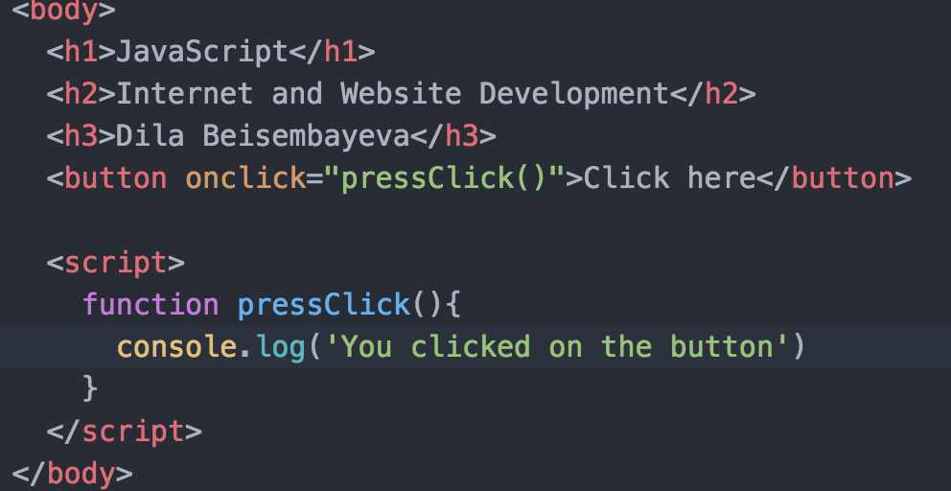
Events

Slide 28
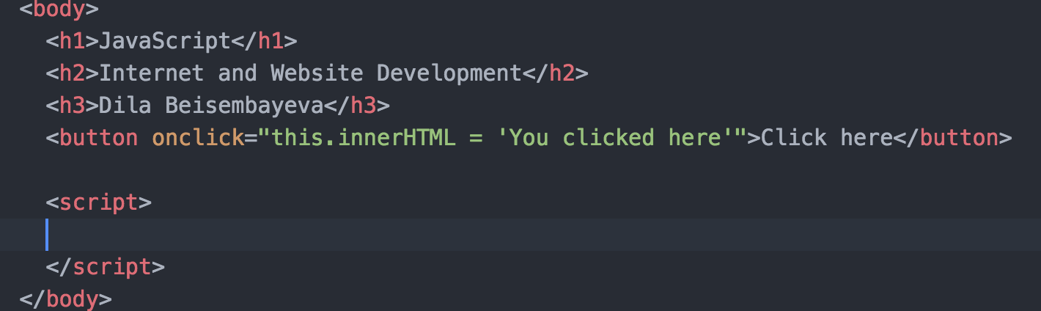
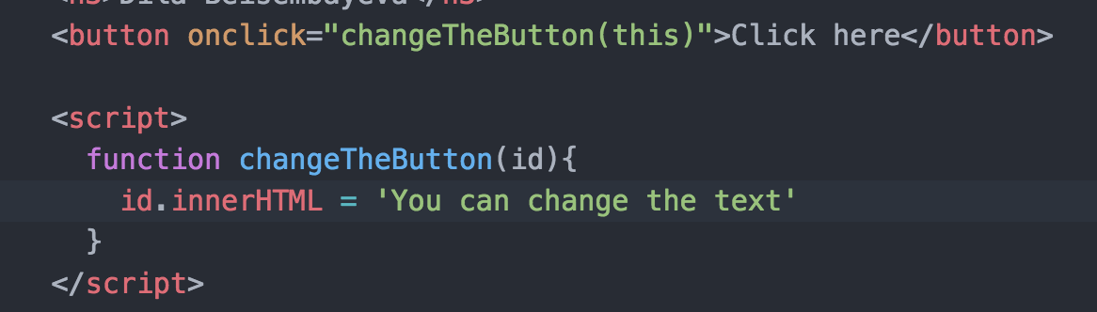

Slide 29
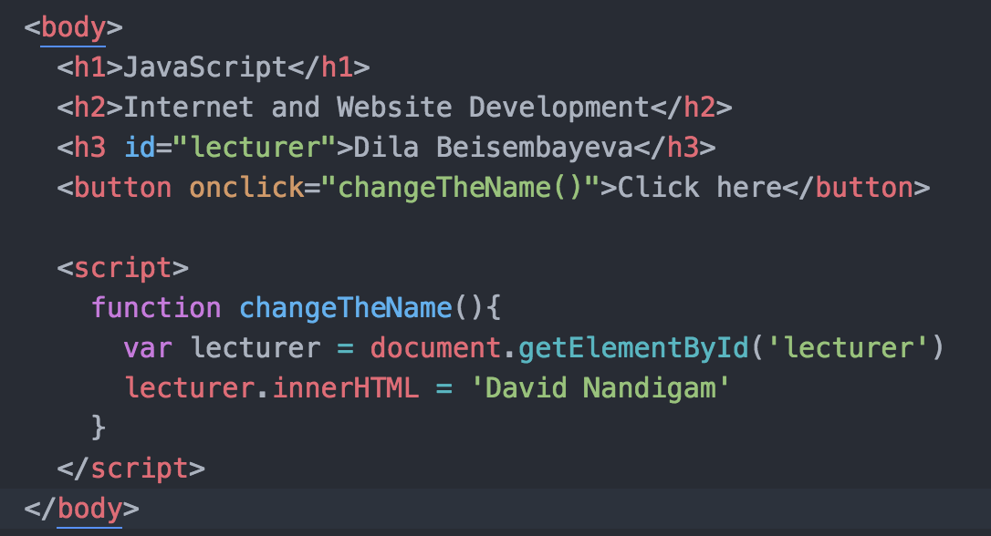

Slide 30
